Slide 1
The Game of Chess Showcase

Slide 2
Use of fundamental OOD concepts
Inheritance
Getters
Setters
Attributes
Methods
Modularity
Overloading

Slide 3
Use of at least 3 design patter

Slide 4
Testing for correctness

Slide 5
Documentation
UML diagrams

Slide 6
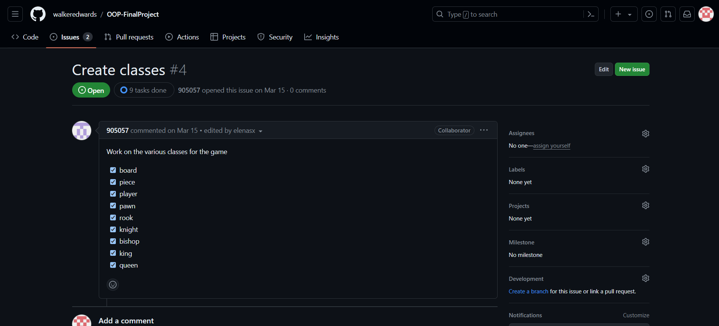
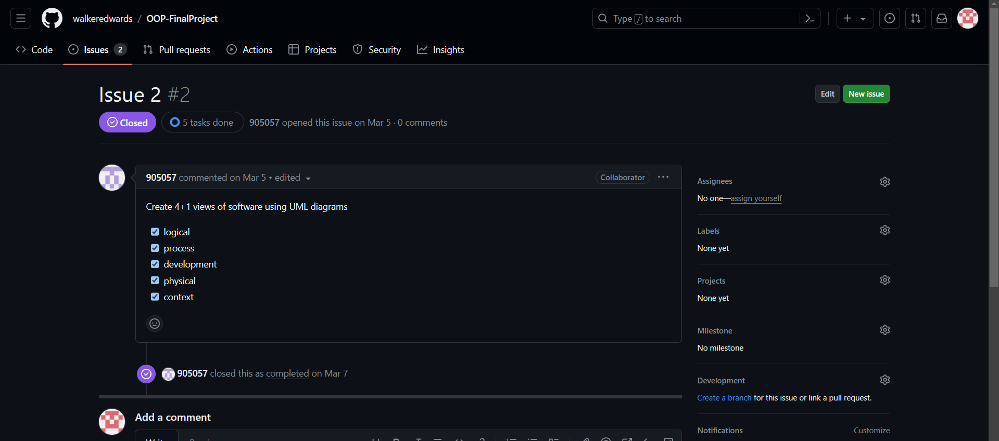
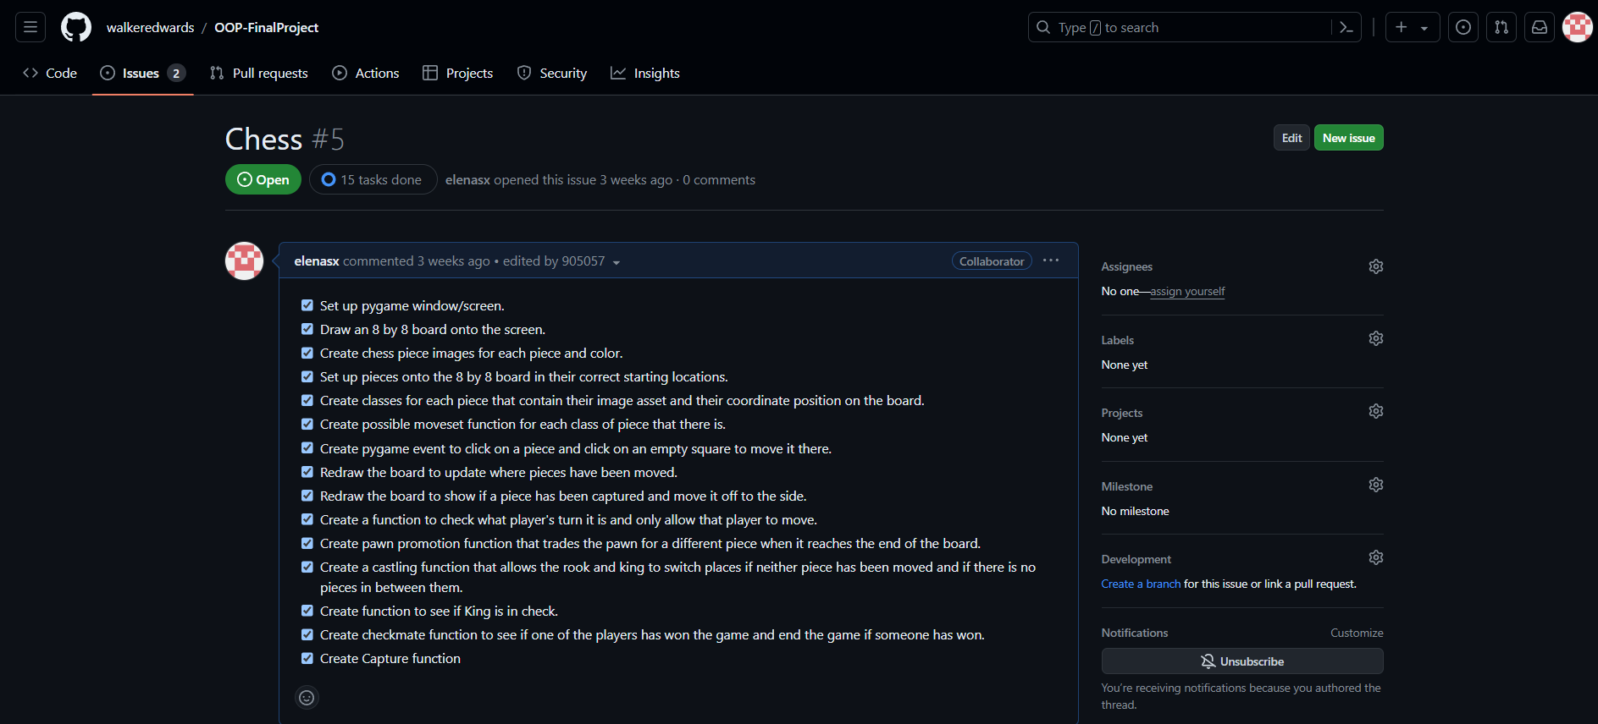
Software management
https://github.com/walkeredwards/OOP-FinalProject

Slide 7
Teamwork

Slide 8
4+1 Views

